Slide 1
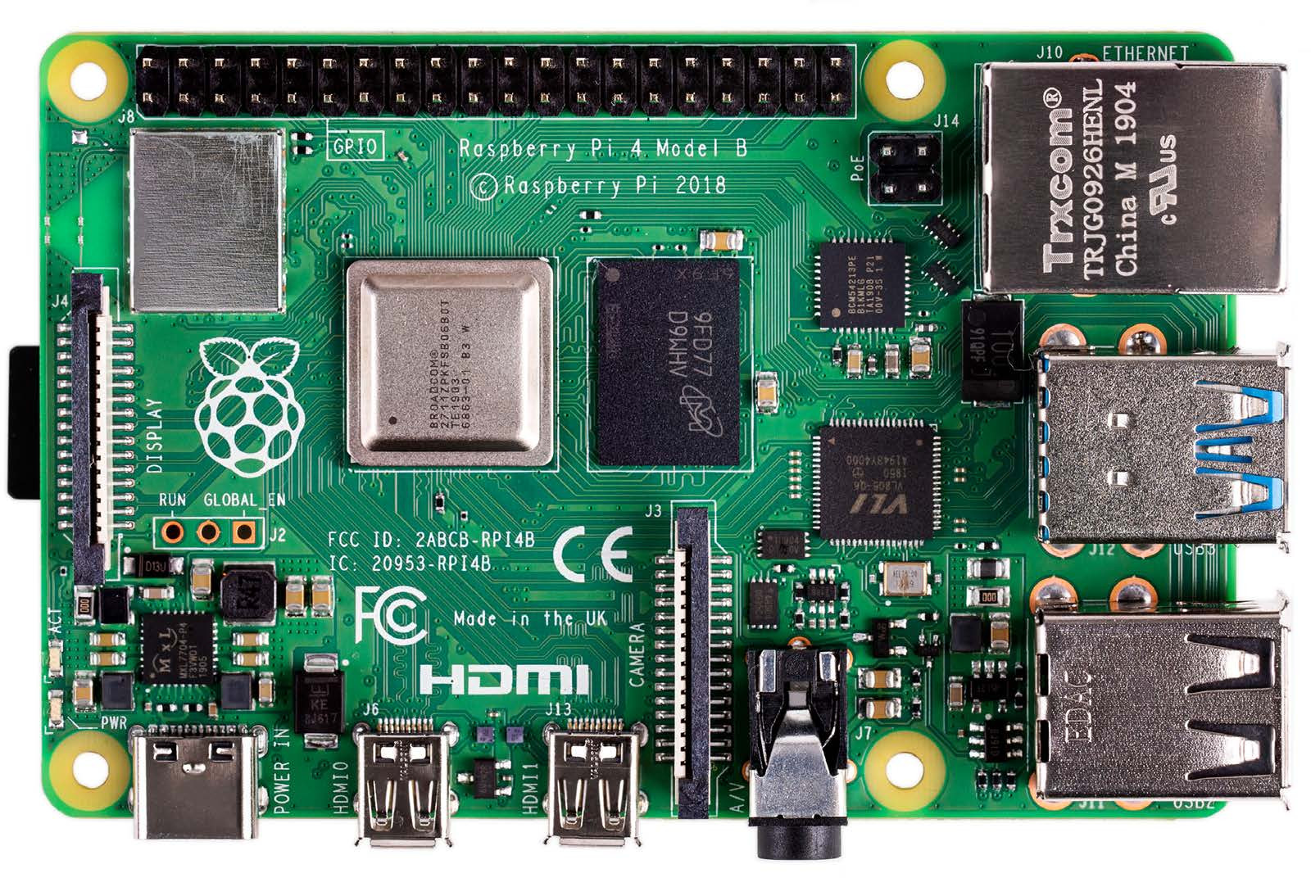
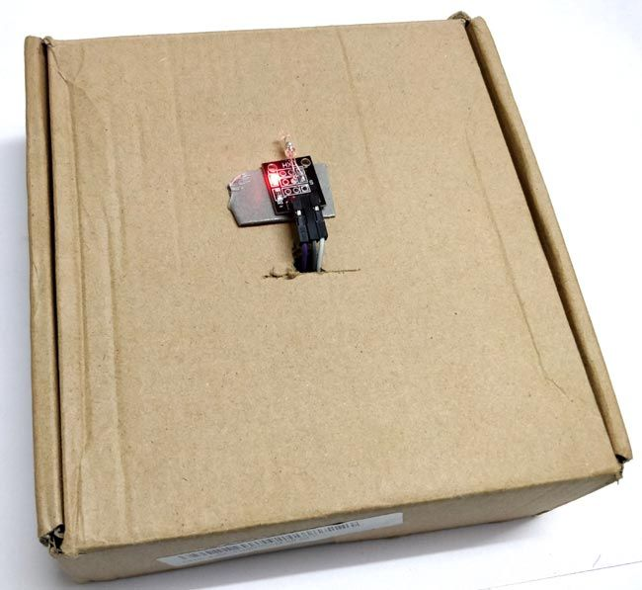



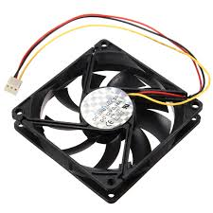
Database creation
Sensor data
ML
Script
Sensor
Raspberry Pi
Web application
Fan Control

